Slide 1

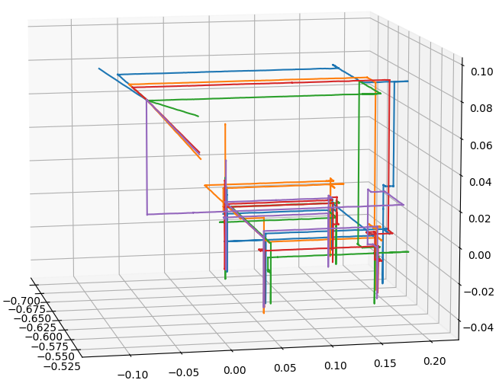
Starting point
Palpation point 3
Palpation point 4
Palpation point 2
Palpation point 1

Slide 2
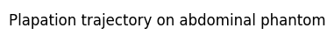
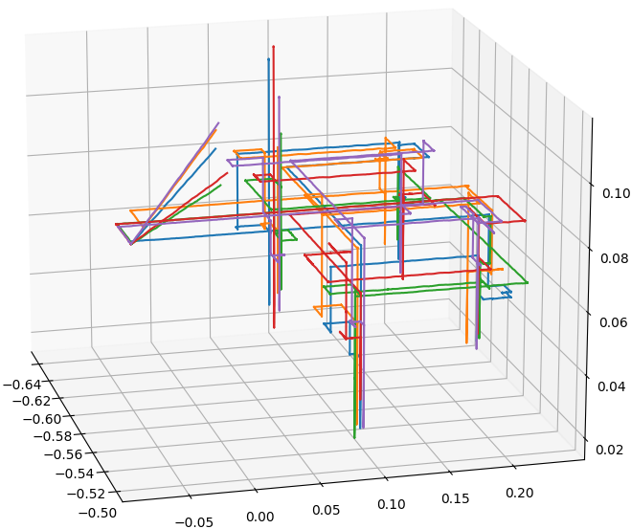
Starting point
Palpation point 3
Palpation point 4
Palpation point 1
Palpation point 2

Slide 3
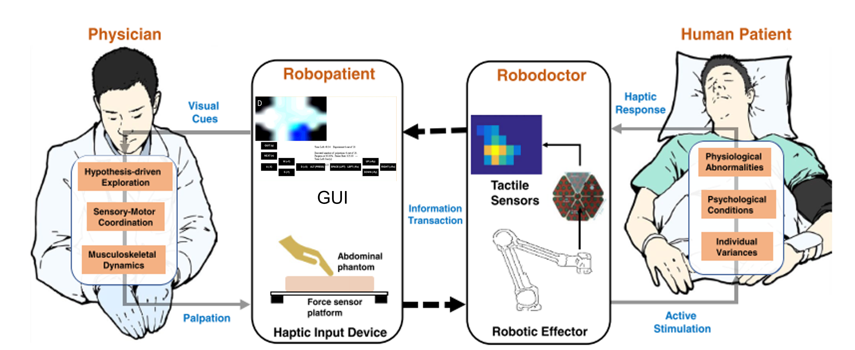



Slide 4
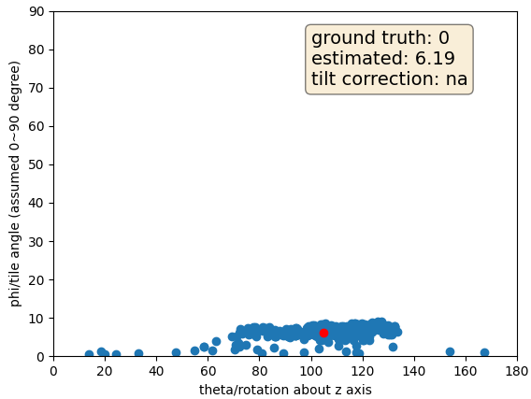
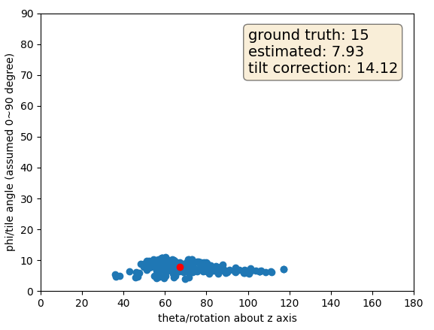
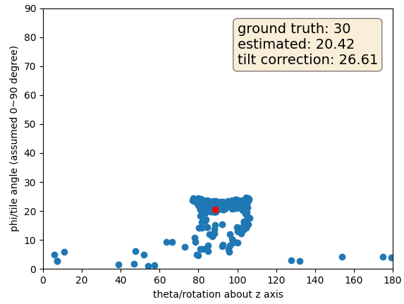
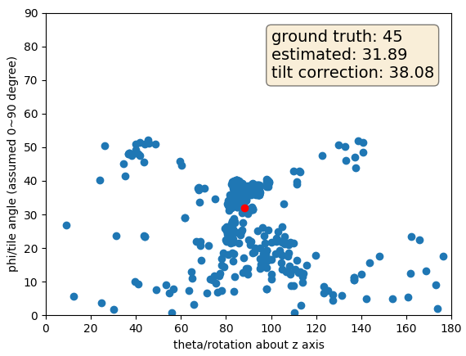
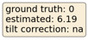
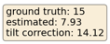
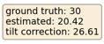
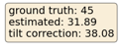
Phantom angle
Rotation about z axis

Slide 5
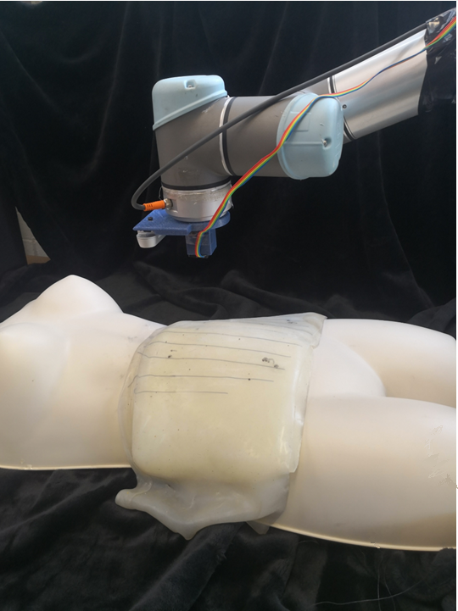
UR5 Robotic Manipulator
Realsense D415 depth camera
Xela XR1944
tactile sensor
Abdominal Phantom

Slide 6
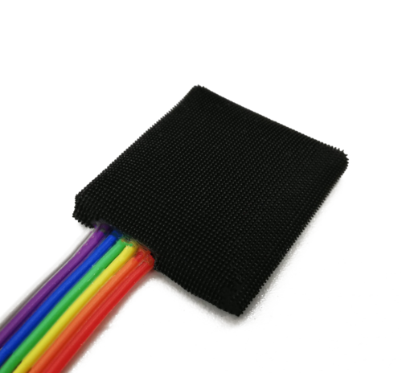




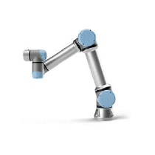

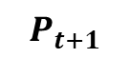
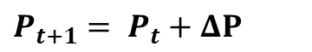


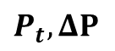

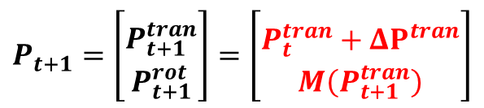
Full Control
$$T$$
$$T$$
$$T$$
$P_{t+1}= P_{t}+ΔP$
Tactile sensor
GUI
Shared Control
Physician
$$T$$
Patient
$P_{t}, ΔP$
$$P_{t+1}=\left[\begin{matrix} \\ P_{t+1}^{tran} \\ P_{t+1}^{rot}\end{matrix}\right]=\left[\begin{matrix} \\ P_{t}^{tran}+ΔP^{tran} \\ M\left(P_{t+1}^{tran}\right)\end{matrix}\right]$$
$$P_{t+1}$$
Input device
UR5

Slide 7
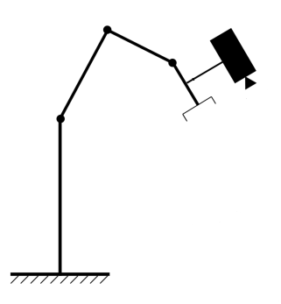
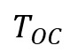
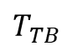
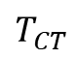
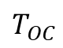
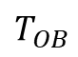
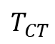
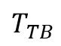
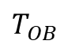
$$T_{TB}$$
Camera
Tool
Camera
$$T_{TB}$$
$$T_{CT}$$
$$T_{OC}$$
Tactile sensor
$$T_{OB}$$
$$T_{CT}$$
$$T_{OC}$$
$$T_{OB}$$
Robot base
Calibration marker
Robot base
Calibration marker

Slide 8
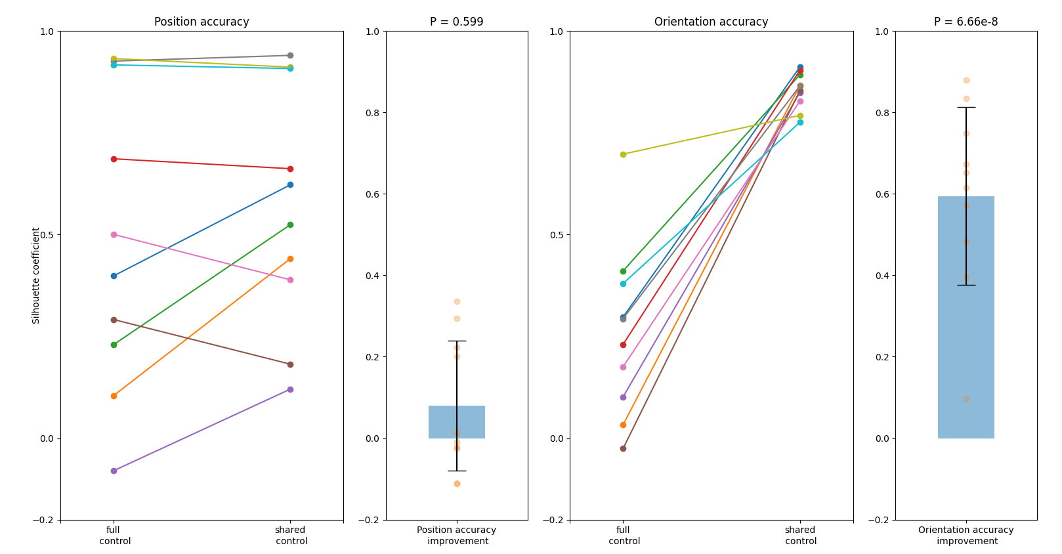
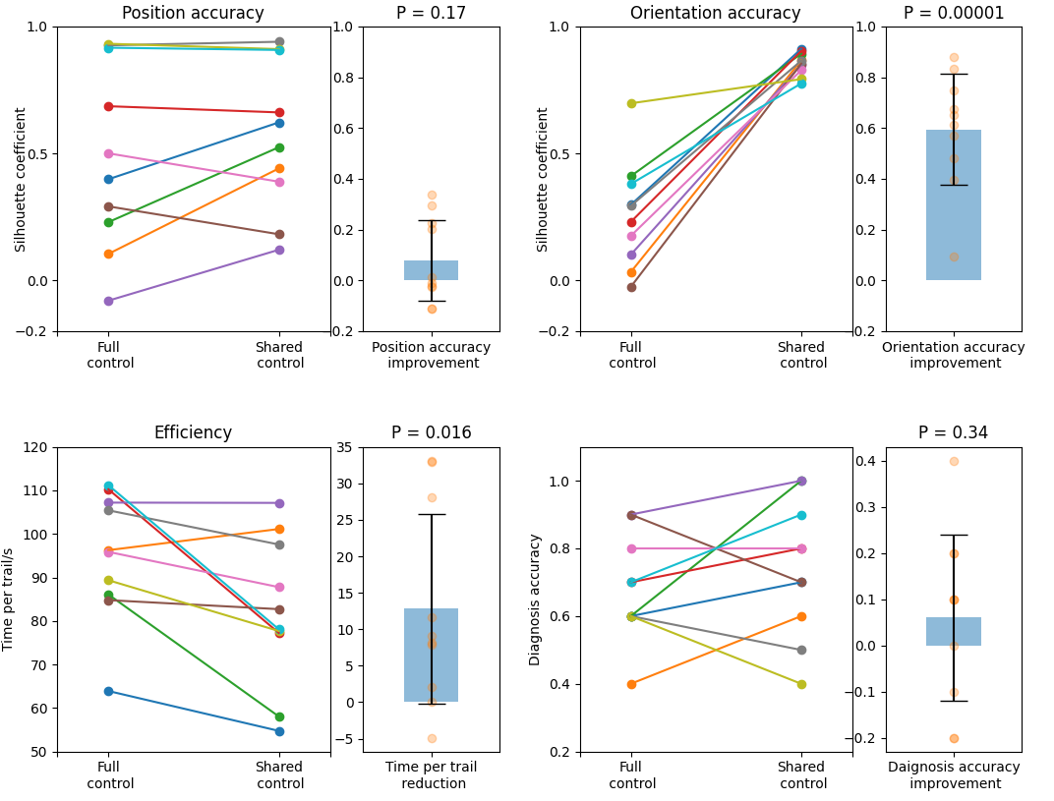
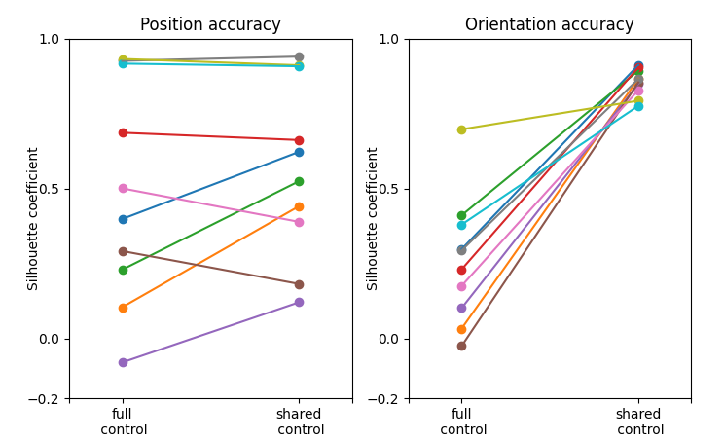

Slide 9
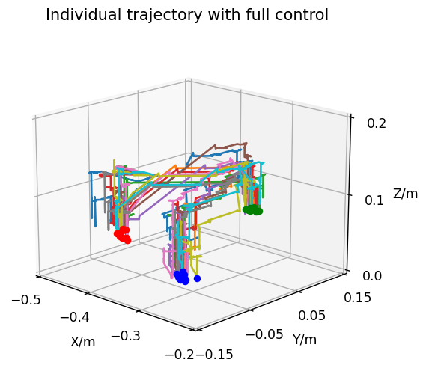
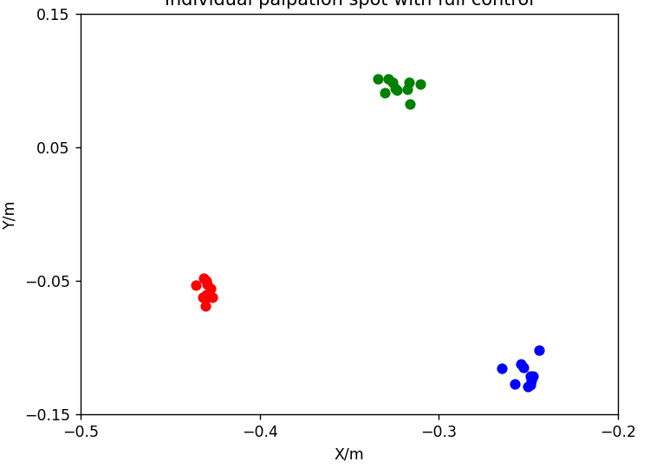
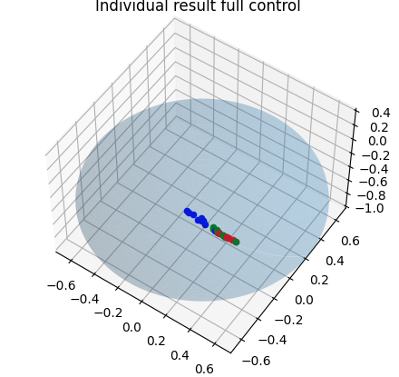
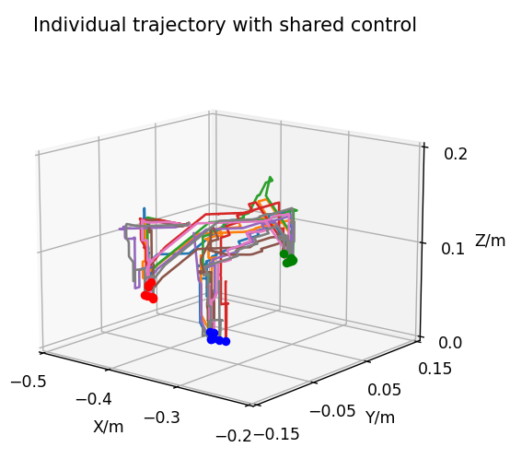
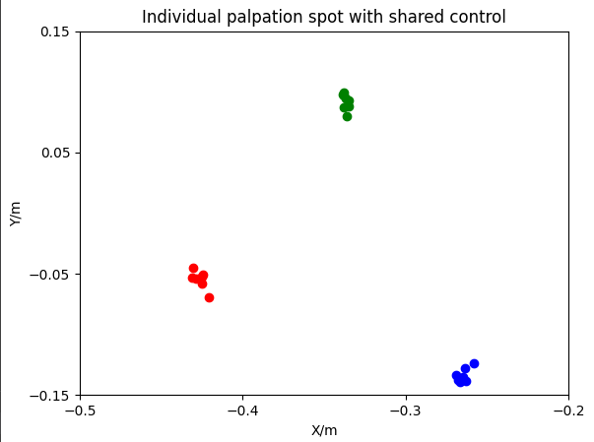
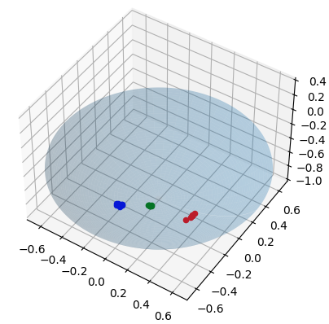
Trajectory
Palpation Spot Position
Palpation Spot Orientation
Full Control
Shared Control

Slide 10
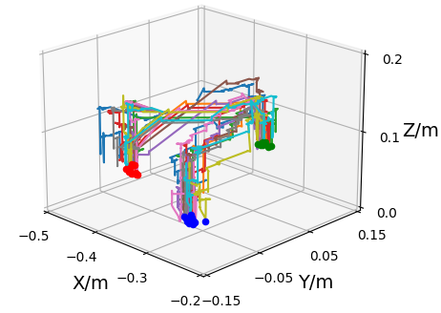
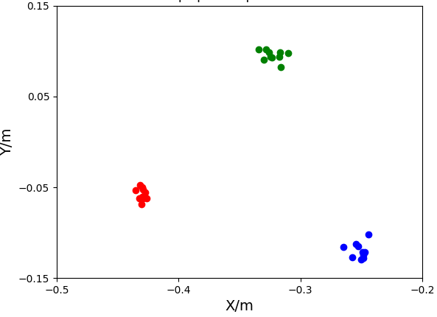
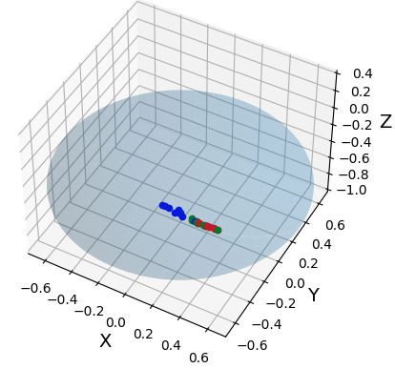
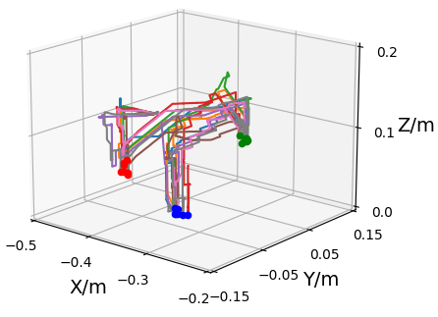
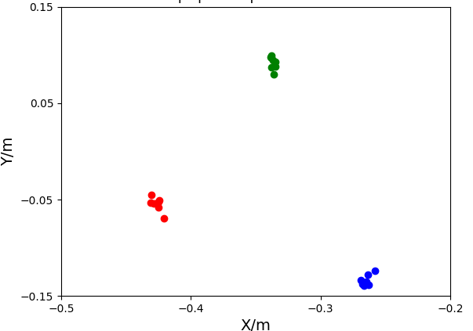
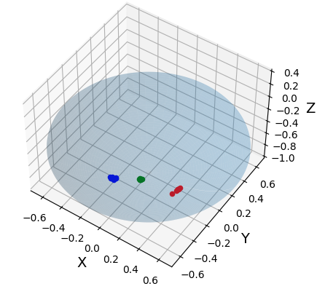
(a) Full Control
(a1) Trajectory
(a2) Position
(a3) Orientation
(b) Shared Control
(b1) Trajectory
(b2) Position
(b3) Orientation

Slide 11
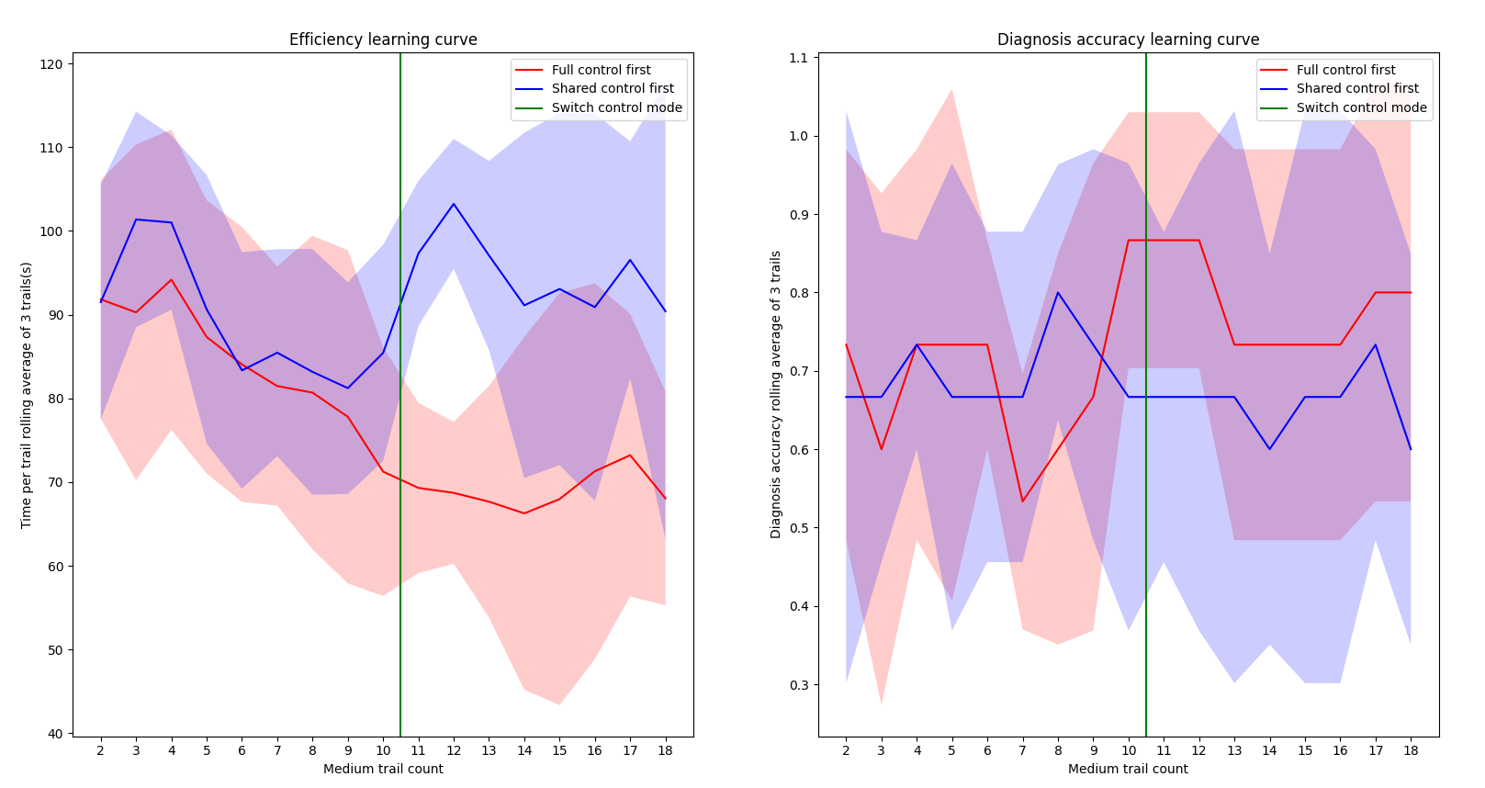
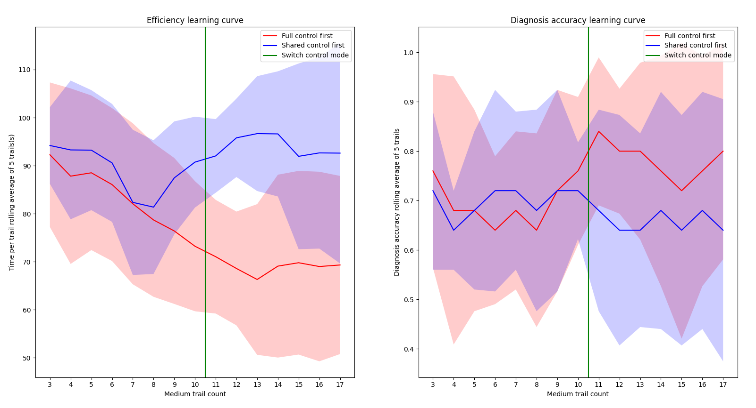

Slide 12
Control key input comparison of all participants (what percentage of time spent on controlling xy/z/Rxy and how many keys pressed simultaneously)

Slide 13
A plot showing what control key is used for a individual participant over their trial

Slide 14
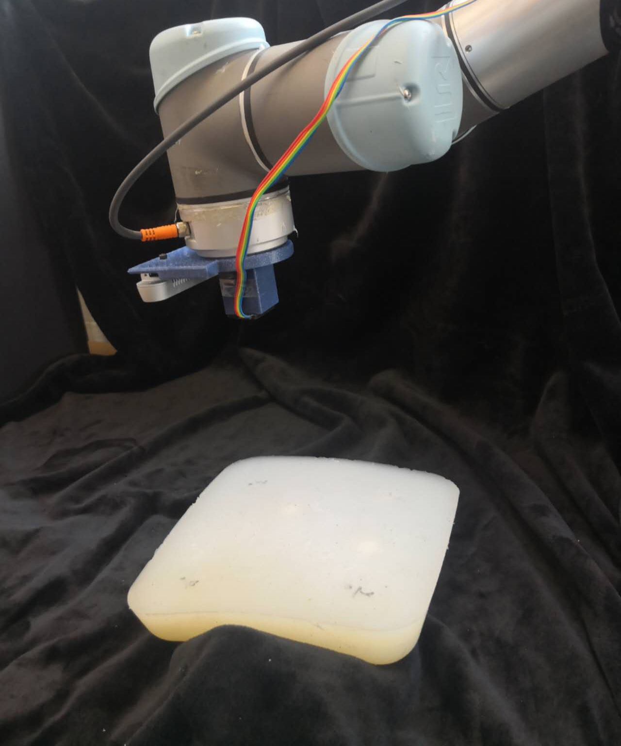
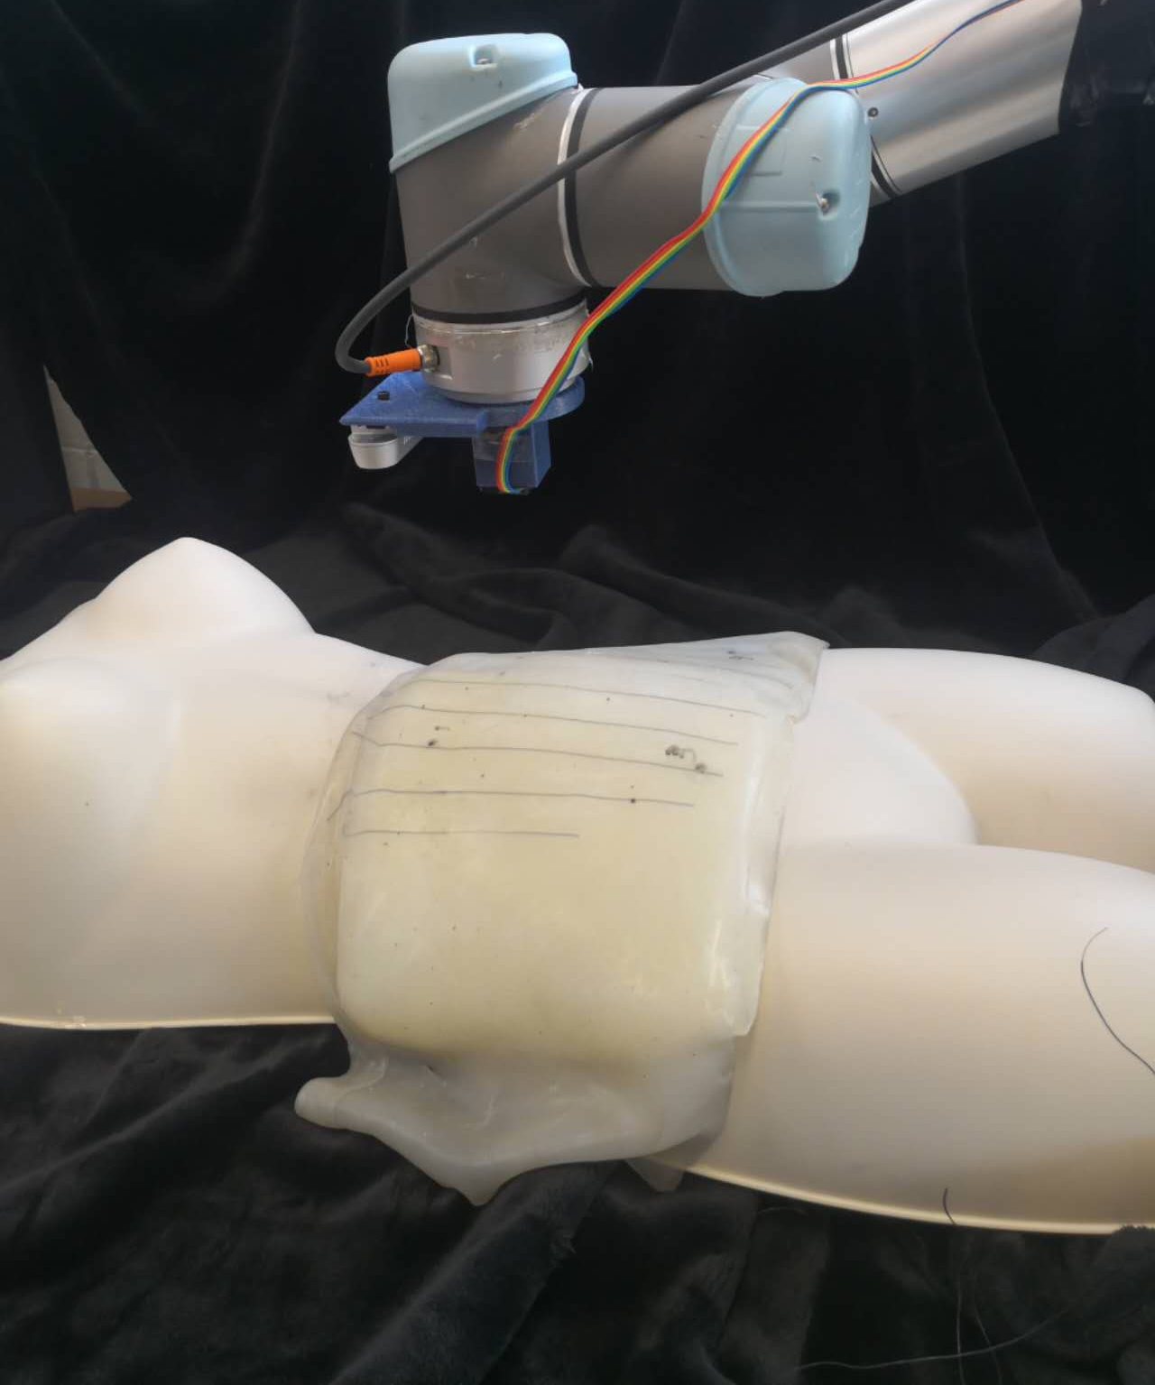
(a)
(b)
UR5
Realsense D415 depth camera
UR5
Realsense D415 depth camera
Xela uSPa 44
tactile sensor
Xela uSPa 44
tactile sensor
Palpation target
Palpation target
Flat Phantom
Abdominal Phantom

Slide 15
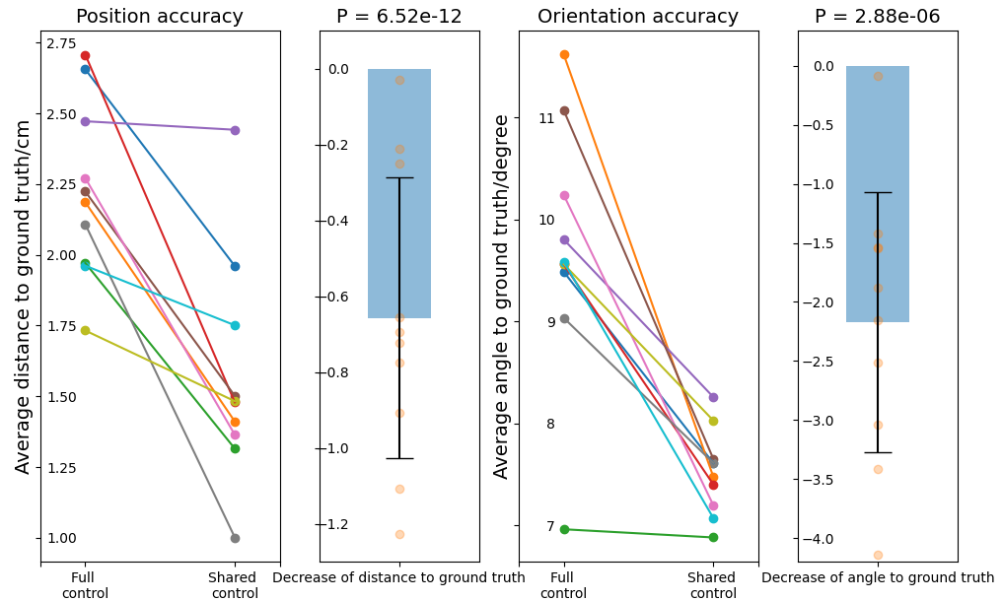
(a1)
(a2)
(b1)
(b2)

Slide 16
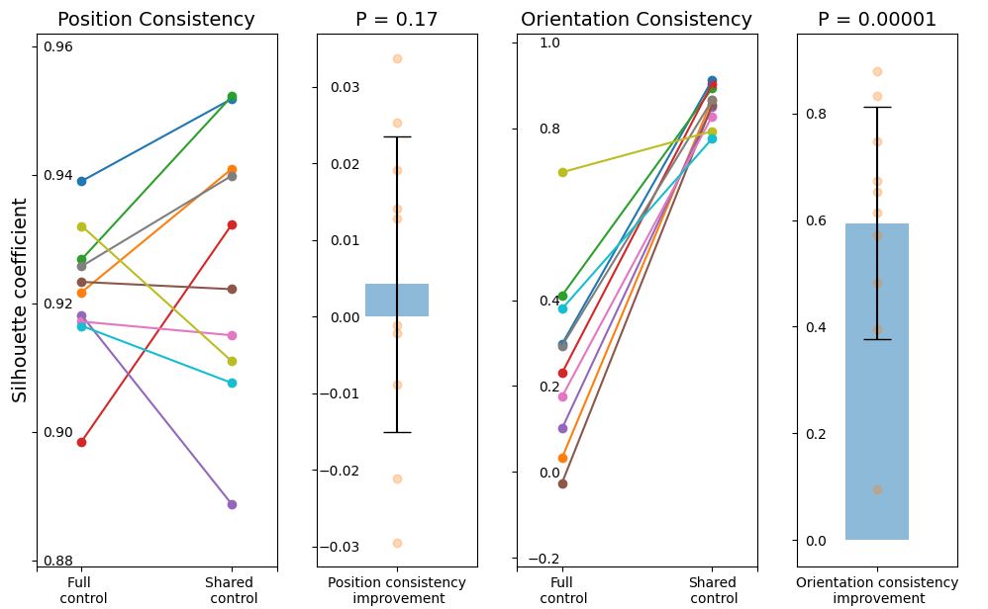
(a1)
(a2)
(b1)
(b2)

Slide 17
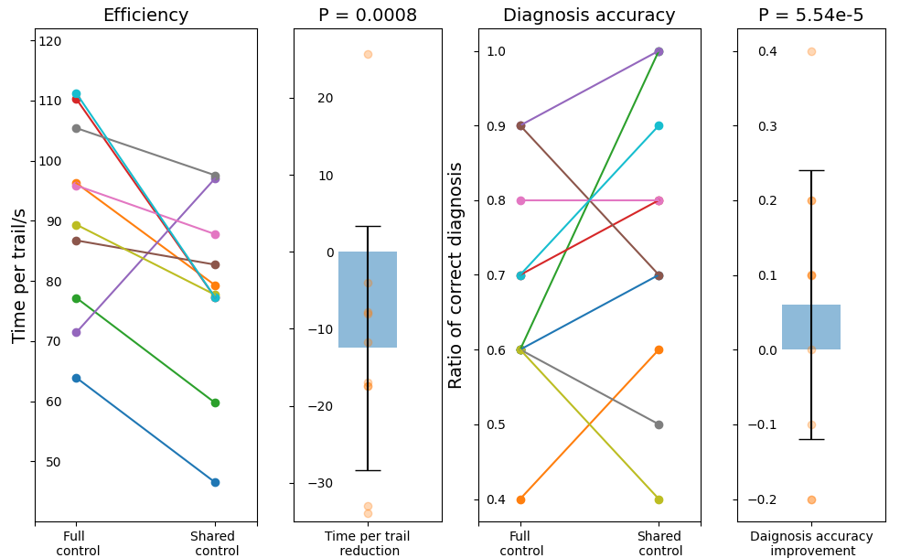
(a1)
(a2)
(b1)
(b2)

Slide 18

(a1)
(a2)
(b1)
(b2)

Slide 19

(a)
(b)

